Slide 1
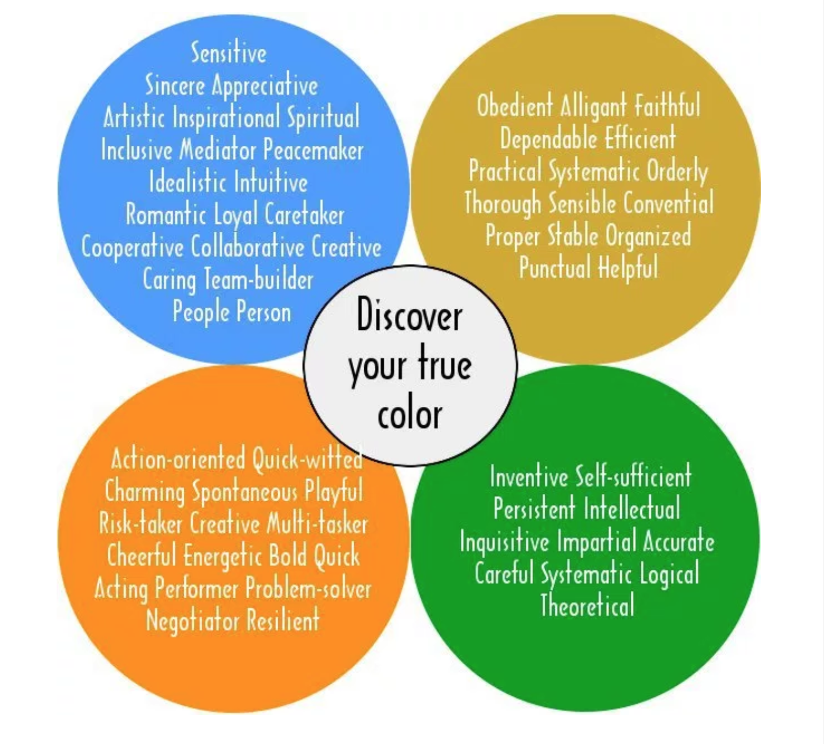
Communicate Styles
TCM 38000 SP2017

Slide 2
Communication styles
What is a communication style?
  The way we share information with others through language
Communication styles help you think about:
  How you prefer to receive information
  How you react under stress
Source: www.psychologytoday.com

Slide 3
Communication styles
What’s in it for me?
  Rational
  Safety
What’s in it for others?
  Experimental
  Emotional
How you use language
  Competitive or Affiliative
  Direct or Indirect
Sources: Orner, R. (2015). Communication and customer service. 24x7 Mag.com. 18-22 and www.psychologytoday.com

Slide 4
ORANGE: Action-oriented, quick witted and problem-solver
Free and spontaneous
Impulsive risk-takers
Dynamic, animated communicators
Optimistic
Thrive on crises
Like to be center of attention
Have great endurance
Competitive
Deal with the here and now
Have difficulty finding acceptance
Drawn to action jobs
Drawn to tools

Slide 5
Perception of ORANGE group members
You see yourself as:
  Straightforward
  Easy-going
  Good negotiator
  Mover and shaker
  Spontaneous
  Friendly
Others may see:
  Rude
  Irresponsible
  Selfish
  Ignoring rules
  Impatient
  Unprepared

Slide 6
In a team …
I am bored and restless with jobs that are routine and structured
I am satisfied in careers that allow me independence and freedom, while using my physical coordination and love of tools
I view any kind of tool as an extension of myself
I am a natural performer

Slide 7
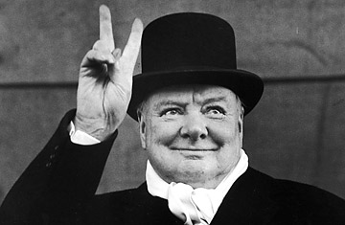
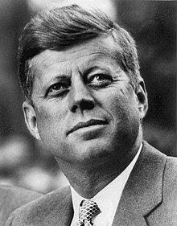
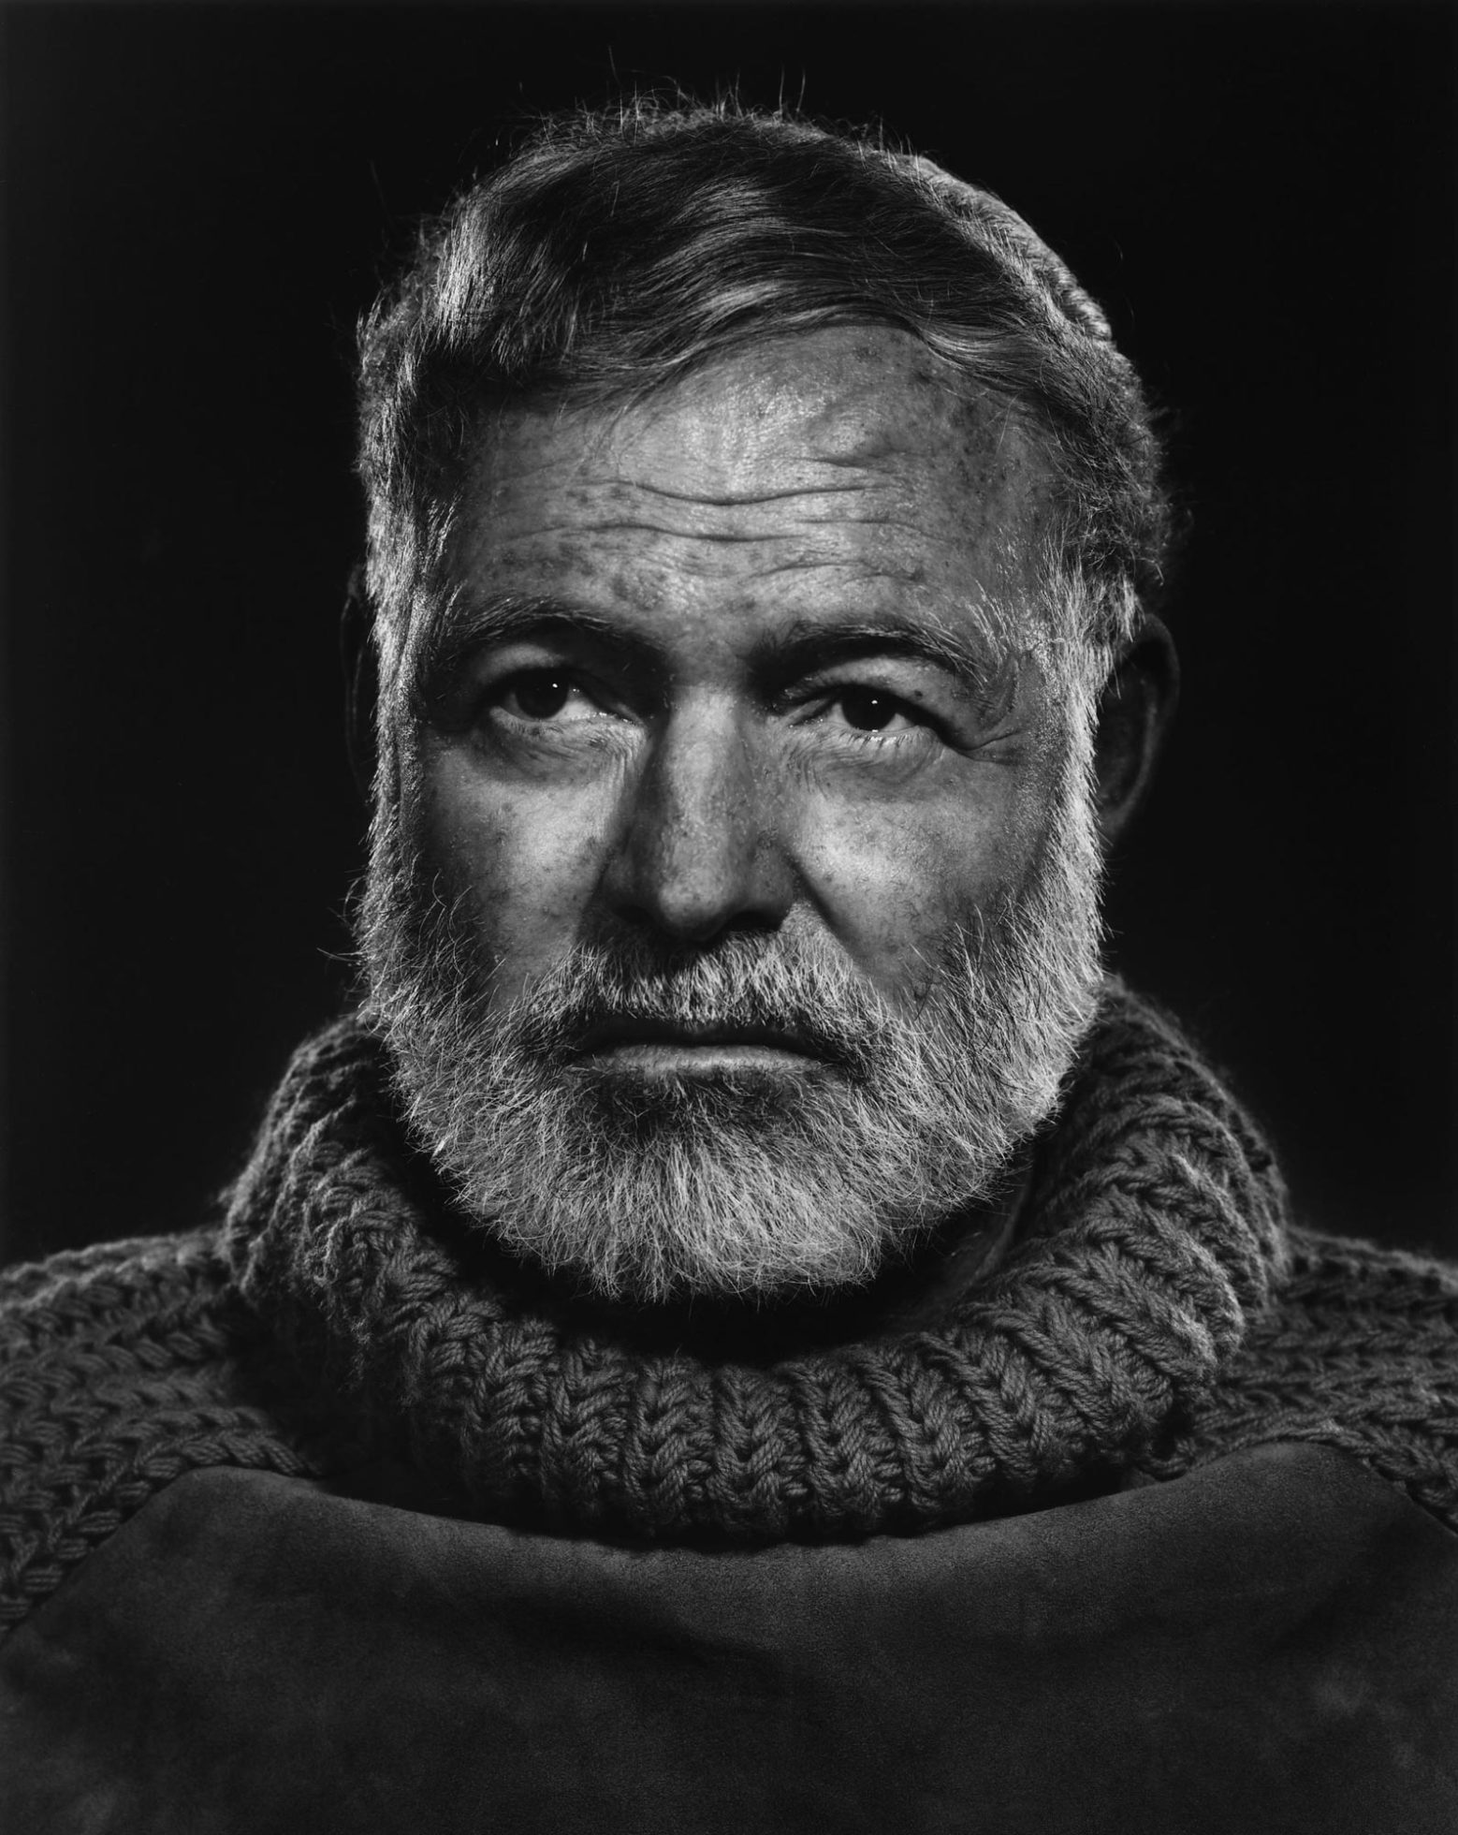
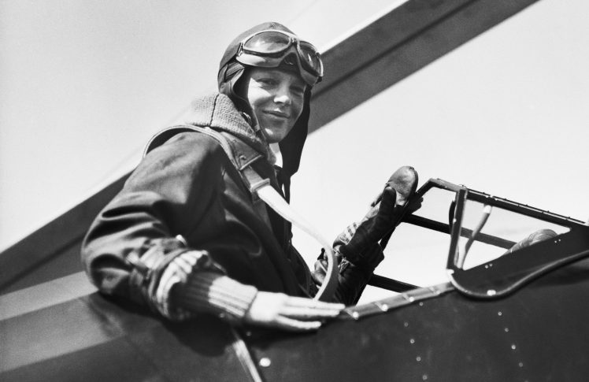
Examples of Oranges

Slide 8
GOLD: Organized, structured, and disciplined
Dutiful and stable
Value organization and rules
Desire punctuality
Schedule their lives
Make and keep commitments
Goal-oriented
Inclined to join groups
Believe work comes before play
Prefer order and cleanliness
Responsible and dedicated
Enjoy positions of authority
Prepare for the future

Slide 9
Perception of GOLD group members
You see yourself as:
  Stable
  Dependable
  Efficient
  Realistic
  Goal-oriented
  Responsible
Others may see:
  Rigid
  Restricted
  Stubborn
  Boring
  System-bound
  Bossy

Slide 10
In a team …
I provide stability and can maintain organization
My ability to handle details and work hard makes me the backbone of many organizations and teams
I am practical and sensible
I believe work comes before play, even if I must work overtime to complete the job

Slide 11
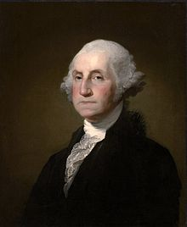
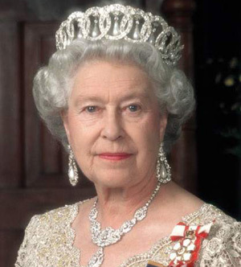
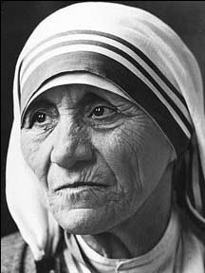
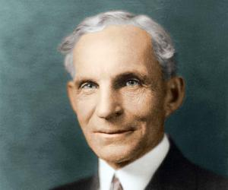
Examples of Golds

Slide 12
GREEN: Visionaries group
Innovative and logical
Seek to understand world
Need intellectual freedom
Question authority
Push to improve
May become intellectually isolated
Slow to make decisions
Value concise communication
Look for intellectual stimulation
Enjoy intriguing discussions
Sometimes oblivious to emotions
Drawn to technical occupations
Analyze and rearrange systems
Focus on the future

Slide 13
Perception of GREEN group members
You see yourself as:
  98% right
  Innovative
  Independent
  Deep thinker
  Able to find flaws
  Witty
Others may see:
  Intellectual snob
  Arrogant
  Emotionless
  Unfeeling
  Aloof
  Critical

Slide 14
In a team …
I am conceptual and an independent thinker
I am drawn to constant challenge in careers
I like to develop models, explore ideas, or build systems to satisfy my need to deal with the innovative
Once I have perfected an idea, I prefer to move on, leaving the project to be maintained and supported by others

Slide 15
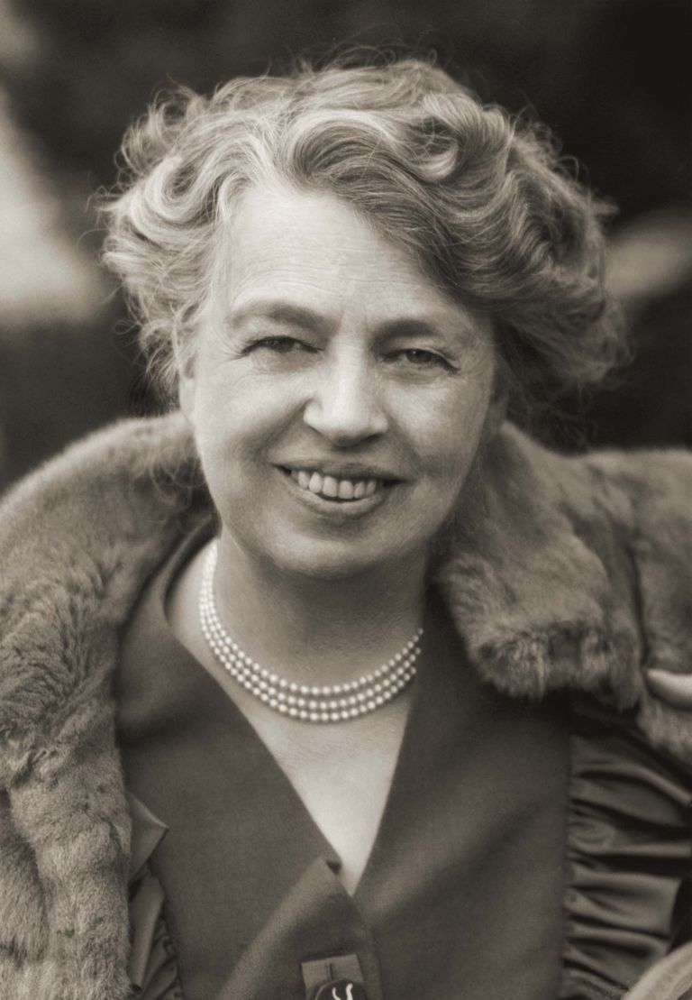
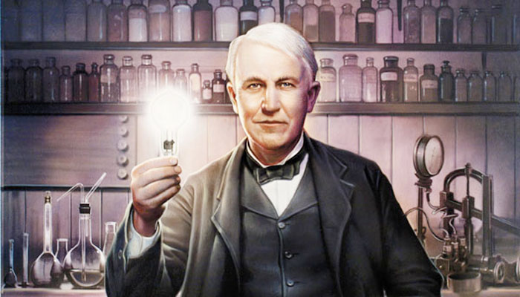
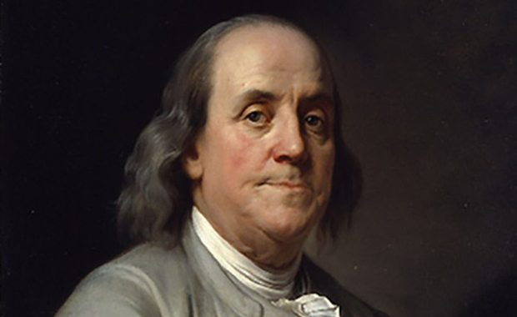
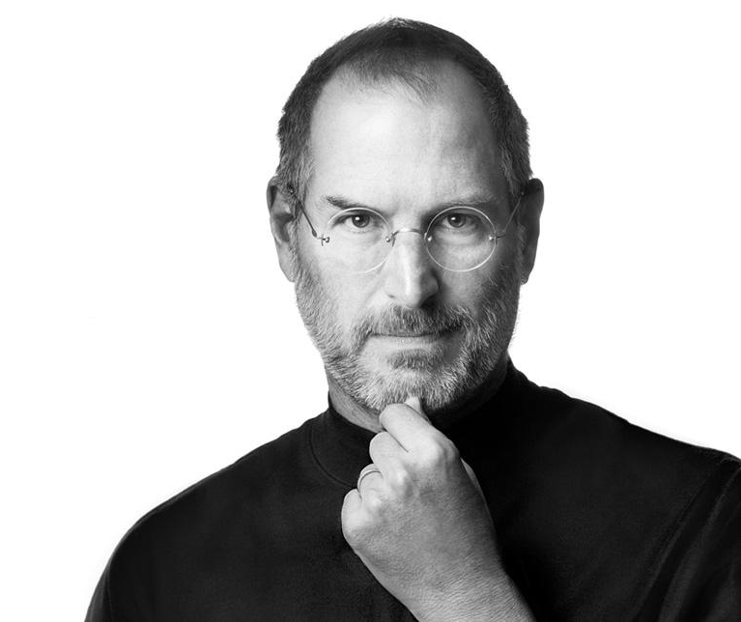
Examples of Greens

Slide 16
BLUE: Artistic, peace-bringer, and sensitive
Need to feel unique
Must be true to themselves
Value close relationships
Encourage expression
Need opportunities to be creative
Comprise and cooperate
Nurture people, plants & animals
Make decisions based on feelings
Need harmony
Adaptable
Drawn to literature and nurturing careers
Get involved in causes
Committed to ideals

Slide 17
Perception of BLUE group members
You see yourself as:
  Romantic
  Spiritual
  Having faith
  Nice
  Flexible
  Caretaker
Others may see:
  Over-emotional
  Mushy
  Unrealistic
  Nosy
  Wishy-washy
  Manipulative

Slide 18
In a team …
I have a strong desire to influence and motivate others so that they may live more significant lives
I often work in the arts, communications, and education, and helping professions
I am adept at motivating and interacting with others

Slide 19
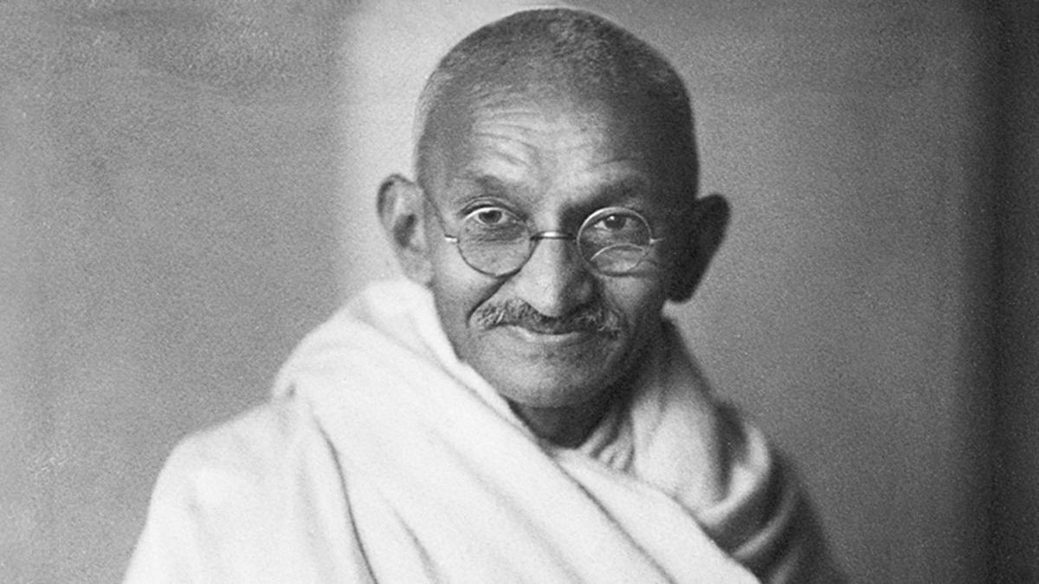
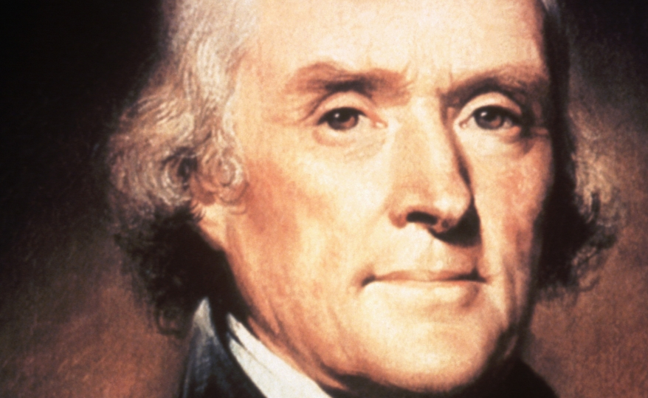
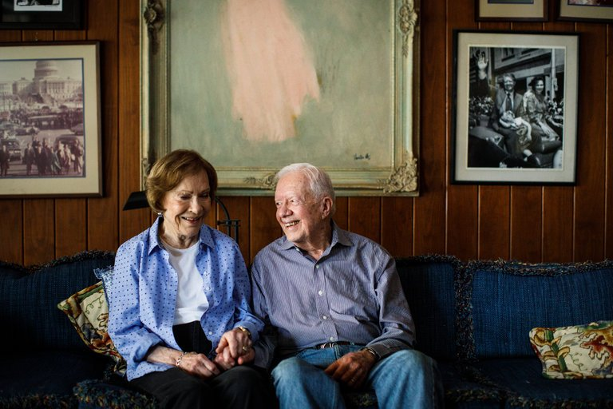
Examples of Blues

